Slide 1

An Exploratory Analysis of Global Covid-19 Data
Name: Victor Oginni
Last updated: 30th September 2022

Slide 2
Table of Content
Objectives of the analysis
About the data
Methodology of analysis
Result and Insights
Conclusions

Slide 3
Objectives
Identify the distribution of covid cases, death and recovery across the globe and identify countries with the highest number of cases and deaths. To also identity the trend of cases and death across a 3 years period.

Slide 4
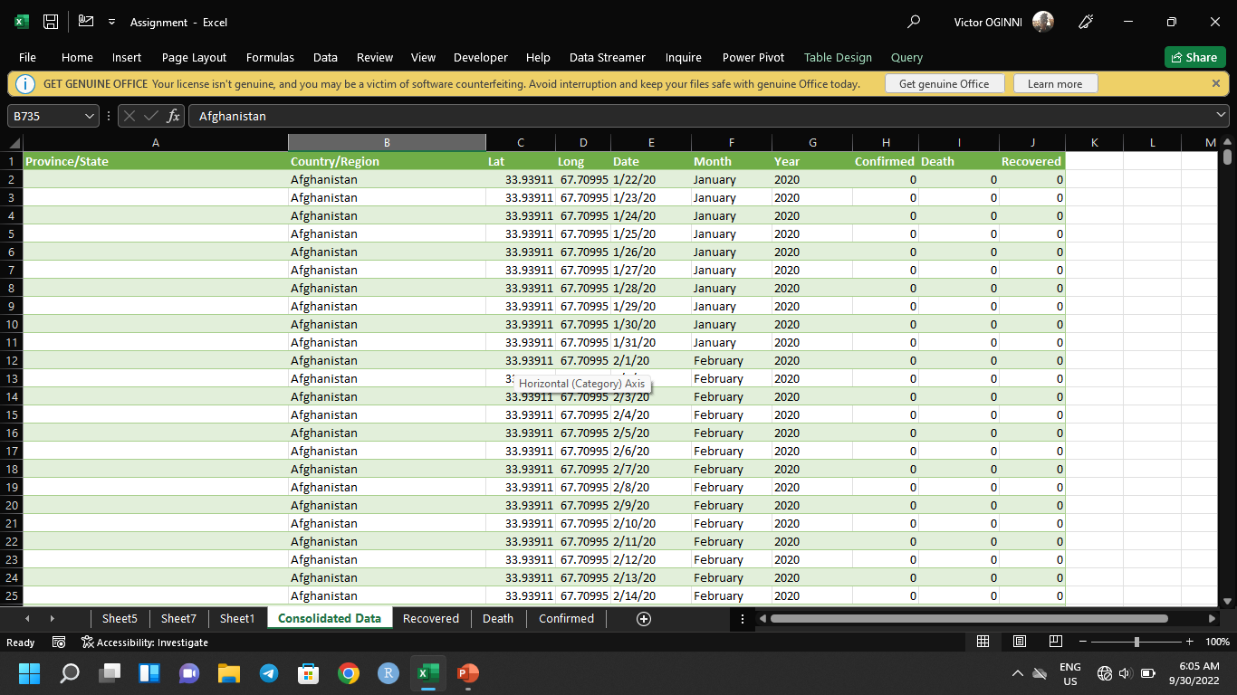
About the data
The data is a time series data that is regularly updated
The source of the data is John Hopkin University, USA
The dataset used contains confirmed cases, death and recovery from countries from 2020-2022

Slide 5
Methodology
The analysis was carried out using Microsoft Excel
The raw datasets were cleaned and merged using Power query
Pivot tables were used to perform calculations
Charts were used to visualize insights

Slide 6
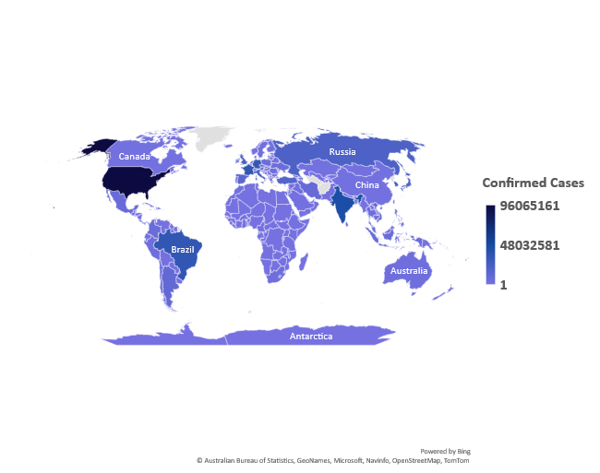
Confirmed cases
North America, South America, Europe and Asia have high number of confirmed cases.
Africa has a low number of confirmed cases compared to other continents. This could be as a result of undertesting.
The total number of cases as at the time the analysis was made is 602,796,643

Slide 7
Confirmed Cases By Year
Number of cases
The number of confirmed cases continues to increase every year.
There was a 144% increase in confirmed cases in 2020-2021 and a 55.4% increase from 2021-2022

Slide 8
Confirmed Cases (Top 5)
Number of Cases
The United States of America has the highest number of cases in the world, accounting for 16% of the total cases in the world
US is followed by India, Germany, France and Brazil to round up the top 5 countries.
The 5 countries account for 40.2% of the global cases

Slide 9
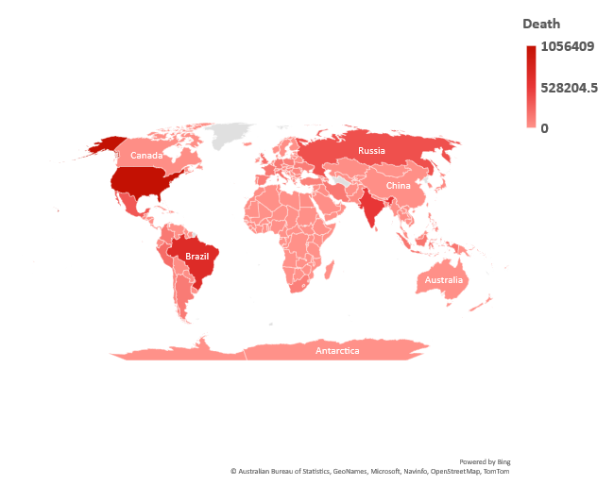
Death
North America, South America, Europe and Asia have high number of confirmed cases.
Africa has a low number of deaths compared to other continents.
The total number of cases as at the time the analysis was made is 8,380,737

Slide 10
Death Cases By Year
Death Cases
The number of deaths increased from 2020-2021 but there has been a decline in 2022
There was a 87% increase in death from 2020-2021 and 17.3% decrease in death from 2021-2022

Slide 11
Death rate
Death Rate
While the number of death cases increased from 2020-2021, there was a decrease in the death rate from 2.27% to 1.75.
The decline continued in 2022, dropping to 0.93
The increased vaccination drive could be a drive for this however, there is not enough data to back the claim.

Slide 12
Death Cases (Top 5)
The United States of America has the highest number of death cases in the world, accounting for 12.6% of the total cases in the world
US is followed by Brazil, India, Russia and Mexico to round up the top 5 countries.
The 5 countries account for 35.6% of the global cases

Slide 13
Conclusion
It is evident from the analysis that Covid-19 is still much around as the number of cases keep increasing
People should be more careful and observe Covid-19 precautionary measures
There should be a continued vaccination drive to protect people from the virus

